Slide 1

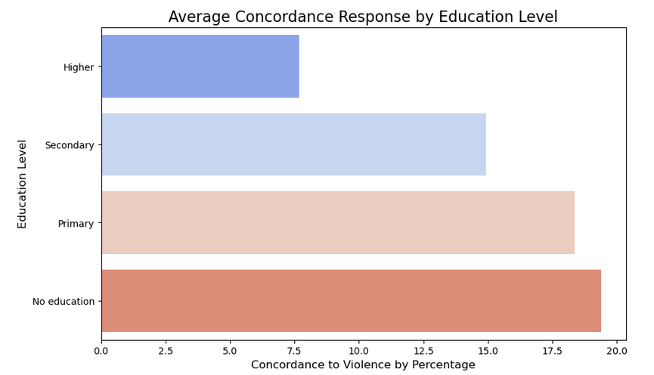
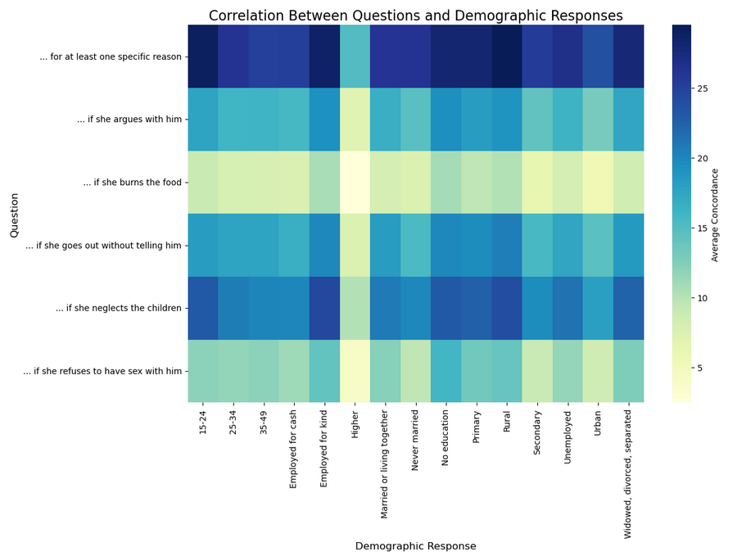
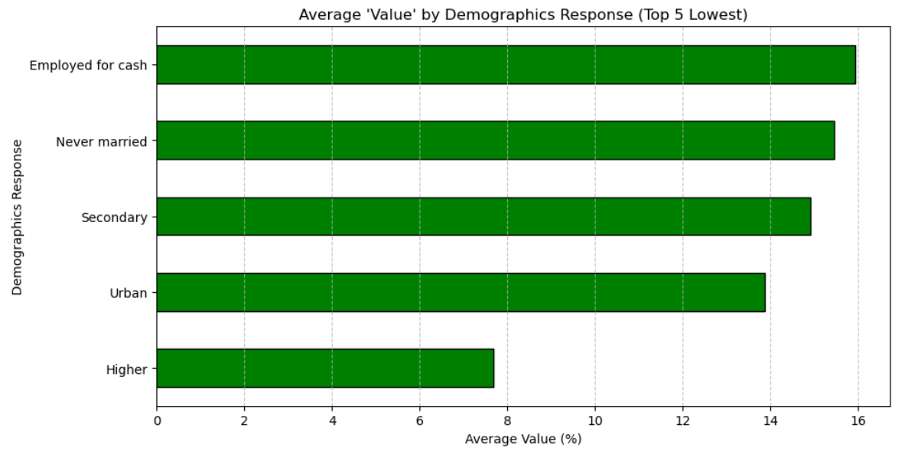
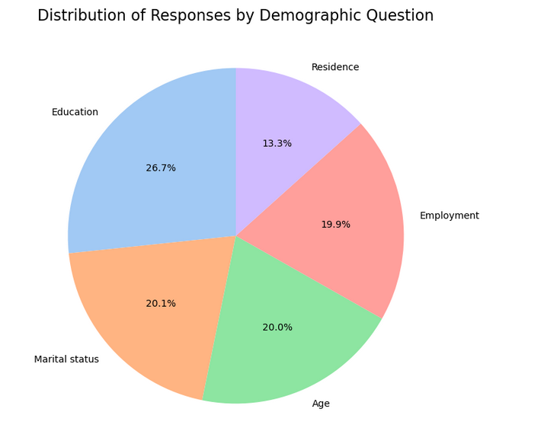
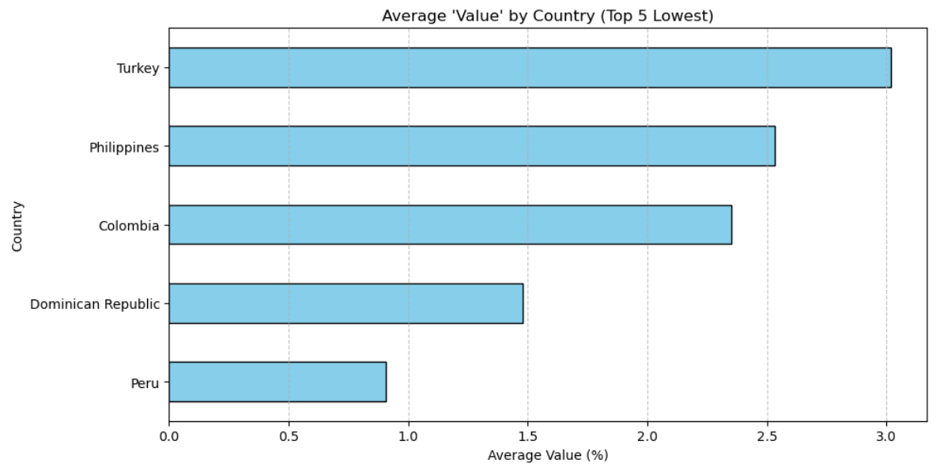
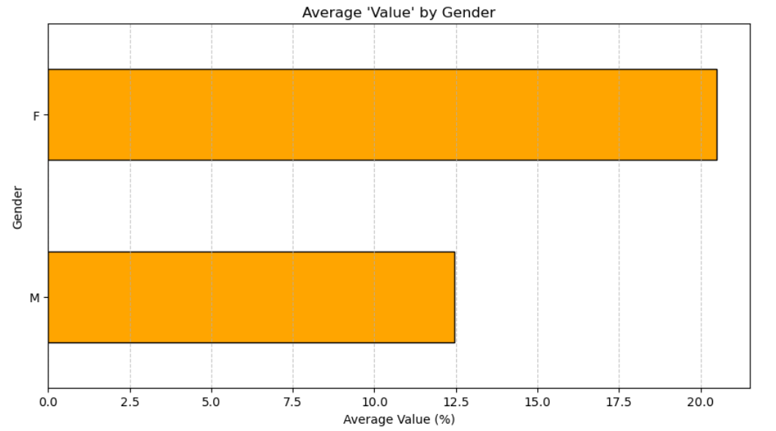
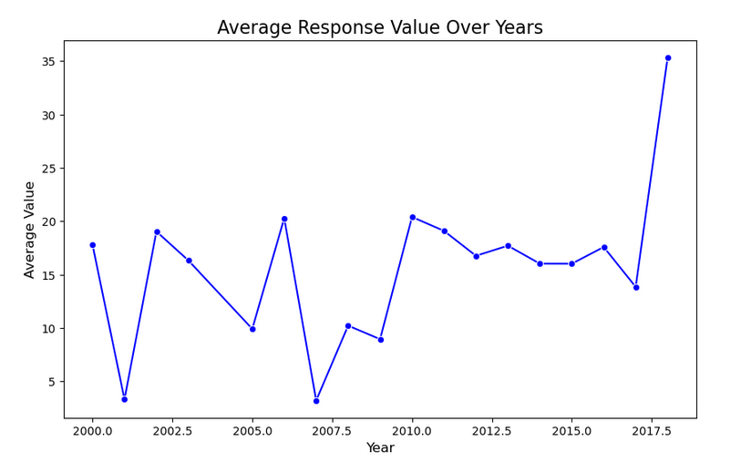
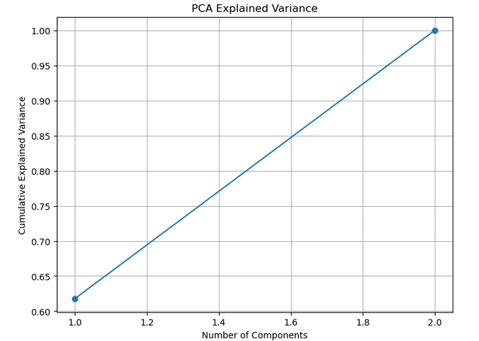
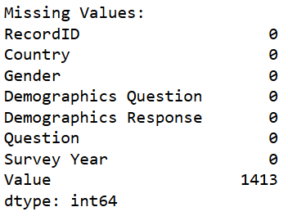
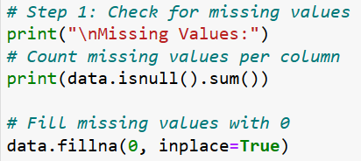

Understanding Violence Against Women and Girls: A Data-Driven Approach
Author: Charles Rocha | Lecturer: Dr Muhammad Iqbal | CCT College Dublin Word count: ?00
1. Introduction
4. Exploratory Data Analysis
6. Key Findings
Violence against women and girls is a critical global issue. This project uses data analysis to identify patterns and insights, aiming to support awareness and policy-making.
EDA revealed trends such as regional variations in violence and correlations between economic factors and incident types, visualized using heatmaps and plots.
Regions with weaker institutions and lower education levels showed higher violence rates. Economic factors strongly correlate with violence types.
2. Dataset Overview
The dataset from Kaggle contains over 3,000 records on violence against women, including attributes like region, type of violence, and incidents reported.
5. Principal Component Analysis
7. Conclusions
3. Data Cleaning and Preparation
PCA reduced the dataset to two key components, retaining most of the variance. This simplified the analysis while highlighting influential factors.
Text size 36pt Arial and exactly 50pt space between lines
Missing data was imputed, outliers removed, and categorical variables encoded. Scaling was applied to prepare the data for deeper analysis. In the column “Value”, null is 0. The code fixed that.
Fig. 1 Caption size 24pt Arial and exactly 34pt space between lines
References
Raphaëlle Rafin, Nabamallika Dehingia, Juncal Plazaola-Castaño and Raj, A. (2024). Rapid surveys on violence against women in crisis contexts: decision-making guidance based on the UN Women Rapid Gender Assessment surveys on violence against women during COVID-19. The Lancet Global Health, [online] 12(11), pp.e1899–e1904. doi:https://doi.org/10.1016/s2214-109x(24)00278-x. (Raphaëlle Rafin et al., 2024)
Shahriar, A.Z.M. and Alam, Q. (2024). Violence against women, innate preferences and financial inclusion. Pacific-Basin Finance Journal, 87, p.102482. doi:https://doi.org/10.1016/j.pacfin.2024.102482. (Shahriar and Alam, 2024)
Sukanya Paradkar, Singh, C., Anand Suryavanshi, Tiwari, A., Beniamino Cislaghi, Nayreen Daruwalla, Osrin, D. and Gram, L. (2024). ‘Mostly women’s issues’ – Gender differences in community responses to a large-scale NGO programme to prevent violence against women in urban India. Women s Studies International Forum, 107, pp.102997–102997. doi:https://doi.org/10.1016/j.wsif.2024.102997. (Sukanya Paradkar et al., 2024)
Our Dedication.Your Journey.

